Slide 1
Social Spending and Income Redistribution in Argentina During the 2000s: the Increasing Role of Noncontributory Pensions
Panel LASA- Friday, 10:30am - 12:15pm, Lincoln
Room 5
The Impact of Taxes and Social Spending on Inequality and
Poverty in Argentina, Brazil, Mexico and Uruguay
Nora Lustig
Tulane University
Carola Pessino
Universidad del CEMA

Slide 2
Background
Crisis 2001-2002 in Argentina: default and devaluation
Real GDP fell 5% in 2001 and almost 12% in 2002

Slide 4
Background
Inequality and Poverty Increased to largest in history, National Poverty Headcount more than 50%

Slide 5
Poverty Rate GBA INDEC (Disposable Income)

Slide 6
Findings
What happened to poverty and inequality after the crisis?
We show that from the peak of the crisis it decreased substantially, but stayed at the level of the 90s, how it was done?
Furthermore, current levels of poverty and inequality rest on fragile stance, fiscally unsustainable and generating perverse incentives towards informality and welfarism.

Slide 7
What happened with Poverty and Inequality after Crisis
The “Observed” Indexes (Disposable Income):
National Moderate poverty decreased from 55% to 30% in 2009, those are the “high” levels of the 90s.
International poverty 4US$ and 2.5 US$ PPP also decreased from 38% to 14% and 23% to 5%.
GINI decreased from 0.520 to 0.447

Slide 8
Gini and Poverty 2003-2009

Slide 9
National Poverty Indexes 2003-2009

Slide 10
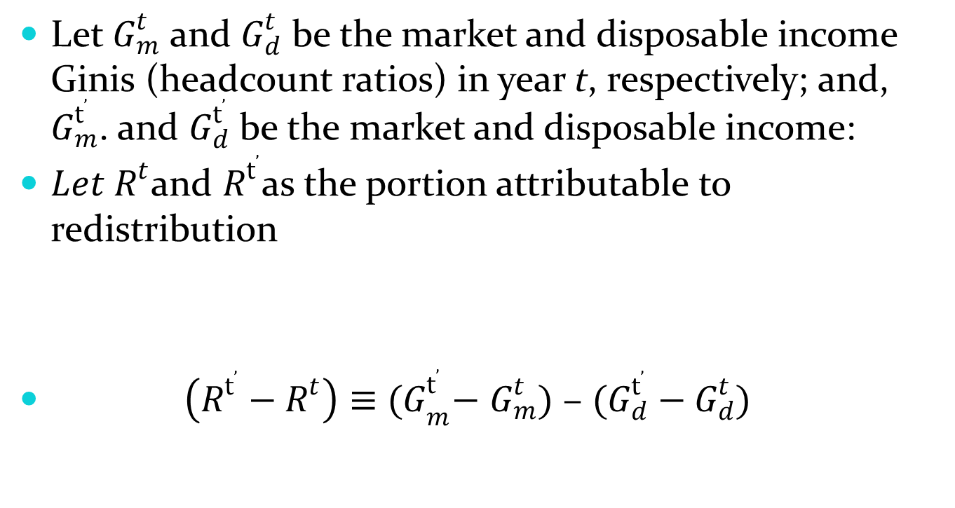

Change attributable to “macro” and to “redistribution”
Let $G_{m}^{t}$ and $G_{d}^{t}$ be the market and disposable income Ginis (headcount ratios) in year t, respectively; and, $G_{m}^{t’}$. and $G_{d}^{t’}$ be the market and disposable income:
${Let R}^{t}$and $R^{t’}$as the portion attributable to redistribution
$\left(R^{t’}−R^{t}\right)≡$ ${(G}_{m}^{t’}−$ $G_{m}^{t})$ – $(G_{d}^{t’}−G_{d}^{t})$
$G_{d}^{t}≡$ $G_{m}^{t}$ - $R^{t}$

Slide 11
Change attributable to “macro” and to “redistribution”
Let $G_{m}^{t}$ and $G_{d}^{t}$ be the market and disposable income Ginis (headcount ratios) in year t, respectively; and, $G_{m}^{t’}$. and $G_{d}^{t’}$ be the market and disposable income:
${Let R}^{t}$and $R^{t’}$as the portion attributable to redistribution
$\left(R^{t’}−R^{t}\right)≡$ ${(G}_{m}^{t’}−$ $G_{m}^{t})$ – $(G_{d}^{t’}−G_{d}^{t})$
$G_{d}^{t}≡$ $G_{m}^{t}$ - $R^{t}$

Slide 12
But contribution of market and redistribution differs
When analyzing contribution of market (before redistribution policies) and redistributive effect:
Between 2003 and 2006 the fall in poverty and inequality mostly explained by market (rebote) and international context.
Between 2006 and 2009, the fall is explained mostly by redistribution, (90% of Extreme Poverty and 40% of GINI coefficient).

Slide 13
Contribution of Redistribution to Change in Disposable Income Inequality and Poverty

Slide 14
Flagship programs
Redistribution occurs principally because of the moratoria previsional, and other non-contributory pensions, and in second place with the AUH that we simulated in this study.

Slide 17
Argentina: Share of Benefits Main Social Programs 1999
 |  | Share of benefits going to each income group
Net Market Income Group |  | y<2.5 | 2.5 < y < 4 | 4 < y < 10 | 10 < y < 50 | y > 50 | Total
ARGENTINA
Jefas y Jefes de Hogar |  | 35.0% | 18.2% | 45.8% | 0.9% | 0.0% | 100.0%
Familias |  | 37.2% | 20.2% | 37.8% | 4.4% | 0.3% | 100.0%
Unemployment Insurance |  | 22.9% | 16.8% | 34.2% | 24.4% | 1.7% | 100.0%
Becas |  | 15.4% | 14.0% | 52.6% | 18.1% | 0.0% | 100.0%
Non Contributory Pensions (inferred) |  | 35.2% | 7.4% | 37.3% | 19.7% | 0.3% | 100.0%
Food |  | 37.2% | 18.6% | 38.6% | 5.6% | 0.0% | 100.0%
Asignación Universal Por Hijo (simulated) |  | 36.8% | 20.9% | 37.0% | 5.2% | 0.2% | 100.0%
At least one of the above (a) |  | 34.6% | 12.2% | 38.2% | 14.7% | 0.3% | 100.0%
Education: All Except Tertiary |  | 22.5% | 15.9% | 47.7% | 13.8% | 0.1% | 100.0%
Education: Tertiary |  | 5.0% | 4.8% | 41.2% | 48.3% | 0.6% | 100.0%

Slide 18
Argentina: Coverage Main Social Programs 2009
 |  | Percent of individuals in each income group who are beneficiaries
Net Market Income Group |  | y<2.5 | 2.5 < y < 4 | 4 < y < 10 | 10 < y < 50 | y > 50 | Total Population
ARGENTINA
Jefas y Jefes de Hogar |  | 5.0% | 3.8% | 2.0% | 0.0% | 0.0% | 1.8%
Familias |  | 36.5% | 30.1% | 11.2% | 0.9% | 0.8% | 12.5%
Unemployment Insurance |  | 1.6% | 2.2% | 0.9% | 0.6% | 0.8% | 1.0%
Becas |  | 1.3% | 2.1% | 1.6% | 0.4% | 0.0% | 1.2%
Non Contributory Pensions (inferred) |  | 33.2% | 19.2% | 17.5% | 9.4% | 3.4% | 16.7%
Food |  | 20.8% | 15.9% | 5.6% | 0.7% | 0.0% | 6.7%
Asignación Universal Por Hijo (simulated) |  | 52.9% | 46.6% | 20.6% | 3.9% | 3.7% | 21.2%
At least one of the above (a) |  | 91.9% | 78.8% | 47.6% | 15.2% | 7.9% | 44.6%
Education: All Except Tertiary |  | 31.1% | 31.1% | 19.0% | 6.6% | 1.1% | 17.2%
Education: Tertiary |  | 1.8% | 2.5% | 4.6% | 6.7% | 2.8% | 4.8%
Health (b) |  | 68.1% | 63.9% | 34.3% | 11.1% | 6.1% | 33.0%
Contributory Pensions |  | 1.0% | 3.1% | 12.9% | 19.9% | 17.4% | 12.9%
Above (all above for benefits except food, at least one for beneficiaries) |  | 90.4% | 76.1% | 45.7% | 14.8% | 7.9% | 43.2%

Slide 19
BENEFITS PER BENEFICIARY BY DAY PPP 2005
 |  | y < 2.5 | 2.5 < y < 4 | 4 < y < 10 | 10 < y < 50 | y > 50 | Total
Jefas y Jefes de Hogar |  | 0.35 | 0.34 | 0.35 | 0.48 | 0.00 | 0.35
Familias |  | 0.54 | 0.52 | 0.55 | 0.97 | 2.31 | 0.56
Unemployment Insurance |  | 1.36 | 1.09 | 1.11 | 1.52 | 2.50 | 1.25
Becas |  | 1.30 | 1.12 | 1.17 | 1.94 | 0.00 | 1.27
Non Contributory Pensions (inferred) |  | 3.87 | 2.06 | 2.38 | 2.90 | 4.19 | 2.84
Food |  | 0.15 | 0.14 | 0.18 | 0.26 | 0.00 | 0.16
Asignación Universal Por Hijo (simulated) |  | 1.22 | 1.14 | 0.96 | 0.88 | 0.85 | 1.07
Above (all above for benefits, at least one for beneficiaries) |  | 2.26 | 1.35 | 1.47 | 2.20 | 2.60 | 1.75

Slide 21
Percentage of People 65 and Older Receiving Any Kind of Pensions: 2003, 2006 and 2009

Slide 22
Problems of this redistribution
Public expenditure increases to more than 40% of GDP financed by distortive taxes, inflation tax and non-orthodox mechanisms.
Part of increase with export taxes, sensitive to commodities 'prices.
Part of the increase related to indirect subsidies to firms, difficult to decrease.

Slide 23
ARGENTINA : Government Spending by Category
(% of GDP)

Slide 24
Financing of Government Spending

Slide 25
Problems of this redistribution
2) The redistribution of second part of decade thanks principally to “moratoria”.
It was partially subsidized through contributory pensions.
Disincentives to contribute to social security, and incentives to informality.

Slide 26
Evolution of Contributory, Noncontributory and Moratorium Pensions 2003-2009: Millions of Individuals

Slide 27
Problems of this redistribution
3) As a consequence, the total number of beneficiaries of social programs increase enormously over decade: from about 5% and not more than 10% in the 90s
With crisis, increase to 24% in 2003
But with the crisis over, in 2009 43% of population depended on social transfers, to get poverty levels similar to the 90s.

Slide 28
Beneficiaries of Social Programs

